Slide 1
Results per method so far
Valid 12-18 UTC, 6-12 hours in advance
Partly only cross validation (QRF)
Partly also testing and training the years
Brier skill scores

Slide 2
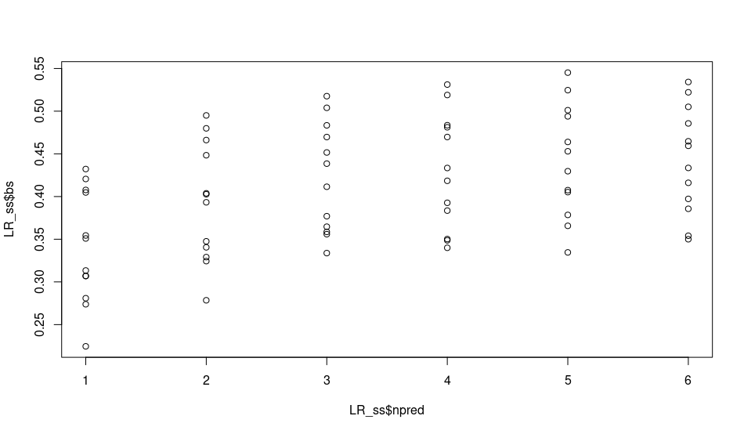
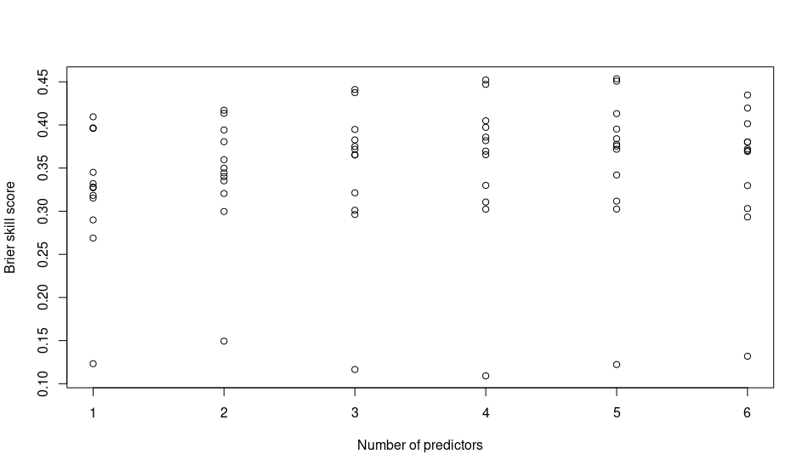
LR
The 12 regions all represented by marker
Training on two alternating years
and testing on the other
3 x 3 times cross validation

Slide 3
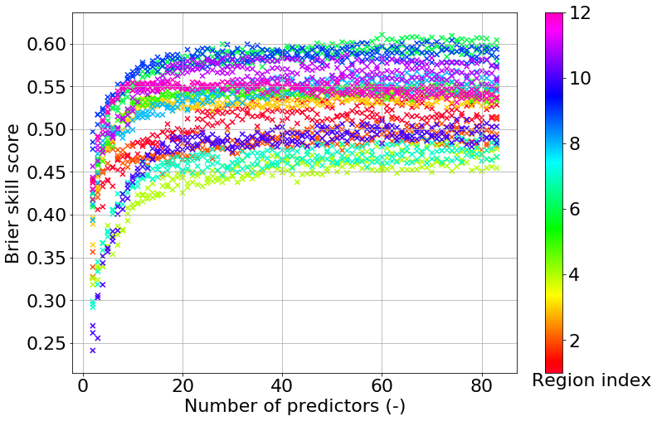
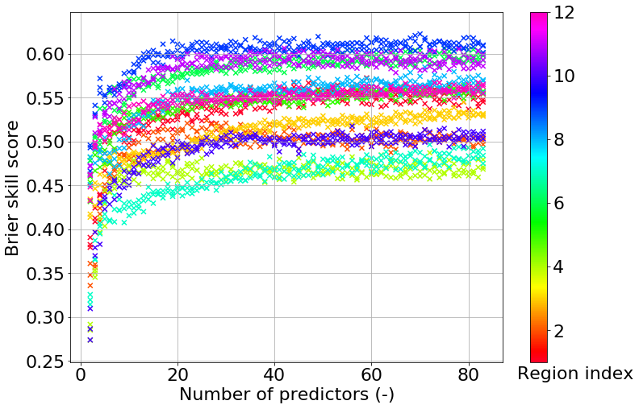
QRF: 0/1
Brier skill scores for lightning occurrence in cross validation, three node size settings
Mtry = 2
Mtry = 10

Slide 4
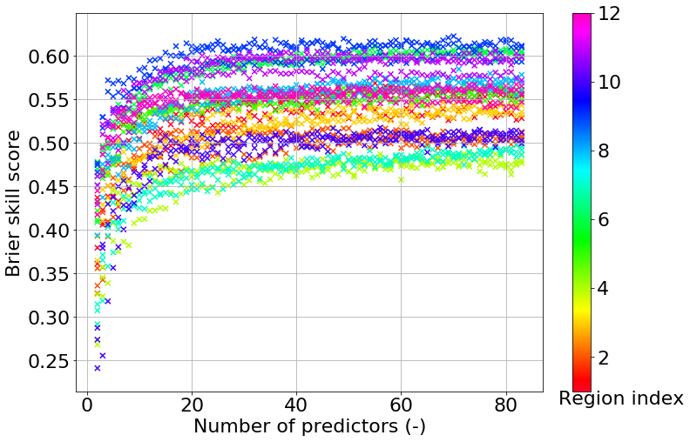
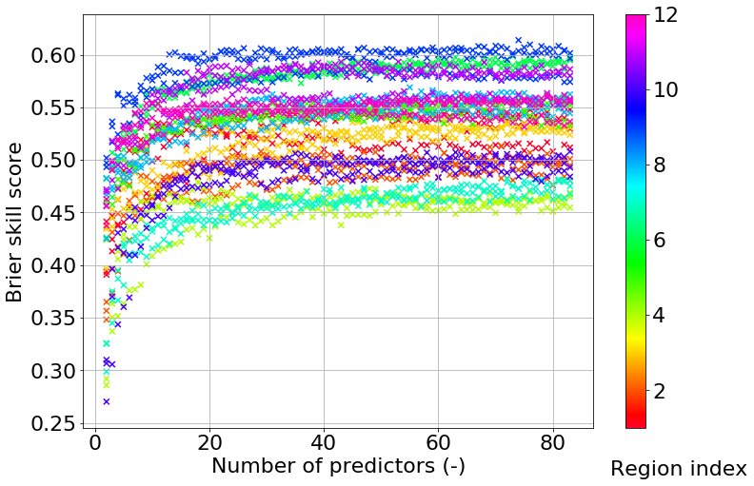
QRF: 0/1
Brier skill scores for lightning occurrence in cross validation, three mtry settings
Node size = 3
Node size = 15

Slide 5
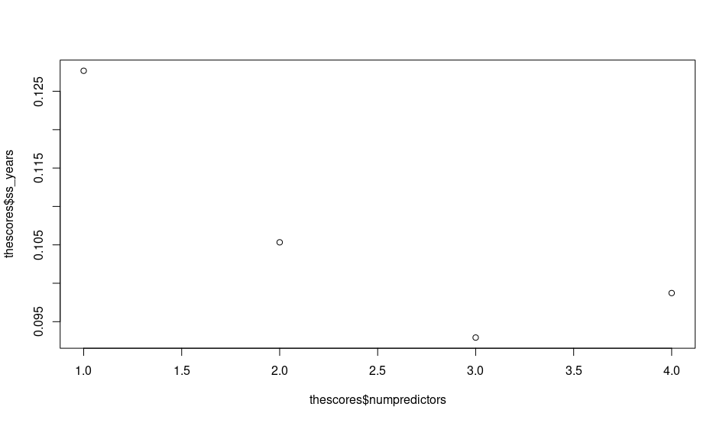
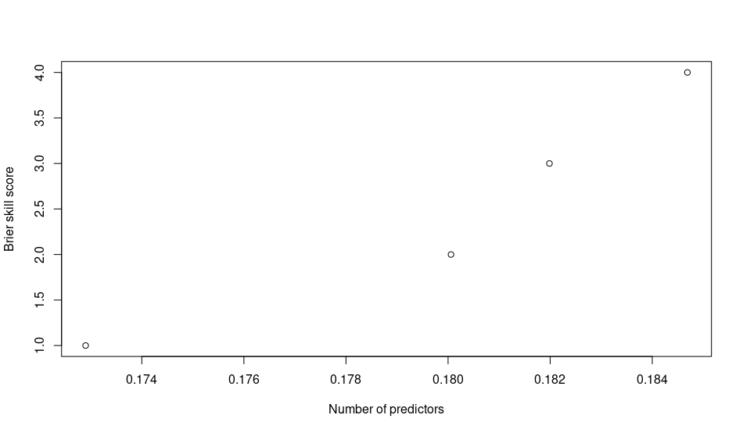
ELR
Excluding a.o. Richardson number (6 in total)
Threshold = 20
Brier skill score vs. number of predictors,
Trained on two and tested on one year
Cross validation sets

Slide 6
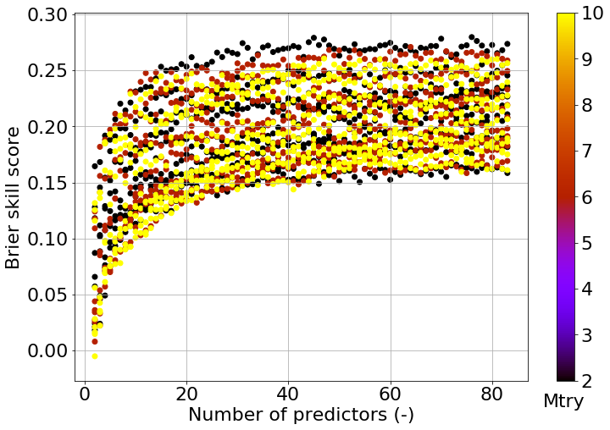
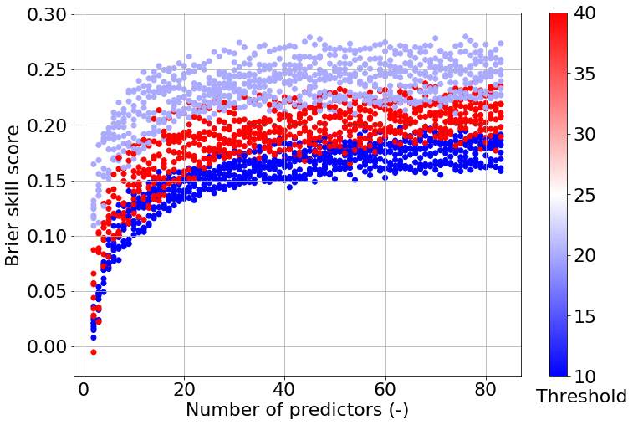
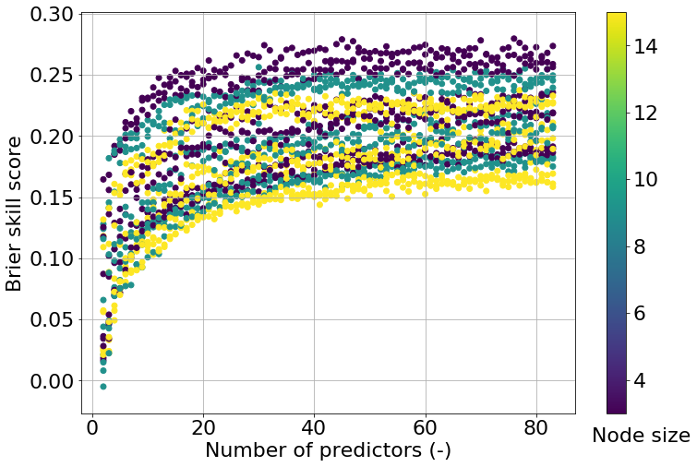
QRF with thresholds
Thresholds 10, 20 and 40

Slide 7
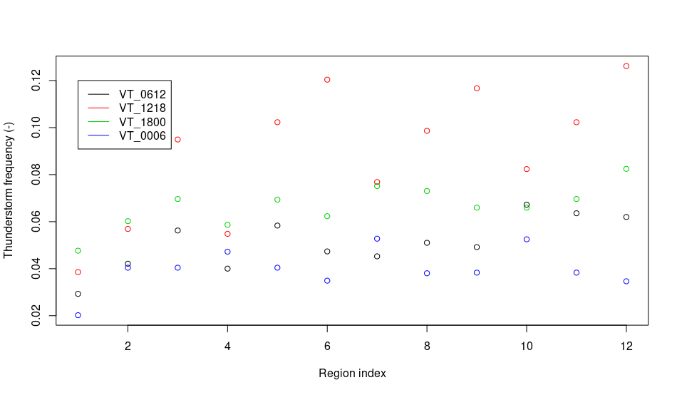
Climatology of lightning occurence
2 or more discharges, relative occurrence in dataset

Slide 8
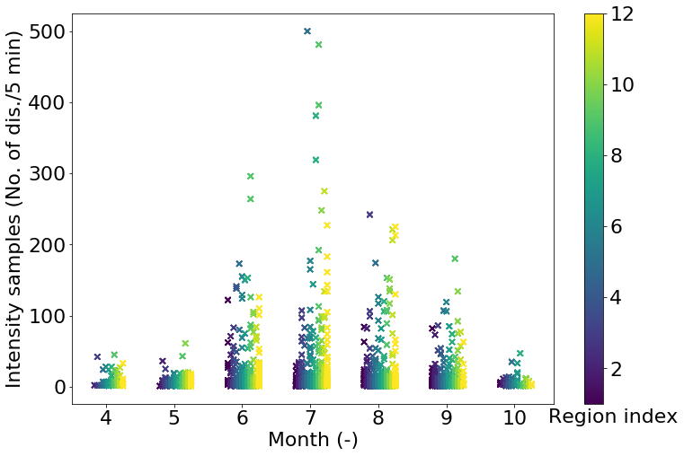
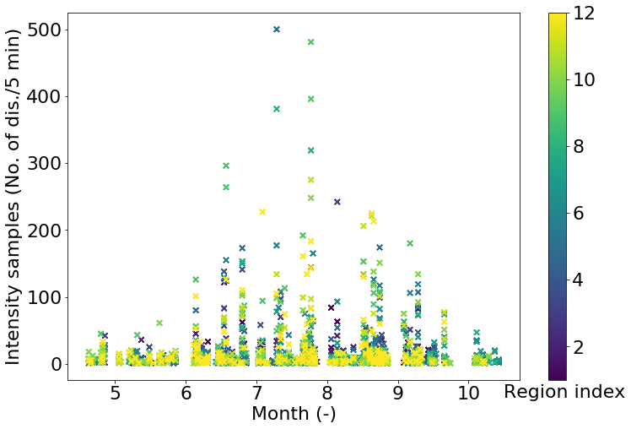
Climatology of intensities
Distribution of intensities through the year
Ungrouped months, same plot

Slide 9
Climatology of intensities
Quantile (cond.) | Dischargerate
0% | 1
10% | 2
20% | 2
30% | 3
40% | 5
50% | 6
60% | 9
65% | 10
70% | 12
75% | 16
80% | 20
85% | 28
90% | 45
92% | 57
94% | 74
96% | 99
98% | 138
100% | 500

Slide 10
Question
If I understood correctly, the dates in ECMWF files were dates for which the forecast was valid?

